Slide 1
Resume Weekly Report
Jasa Konsultan Pengembangan Aplikasi SIGMA SIG 1 2025-2028
Jumat, 07 Maret 2025

Slide 2
Content
1.
Highlights Activity
2.
Activity of The Week
3.
Next Week Activity Plan

Slide 3
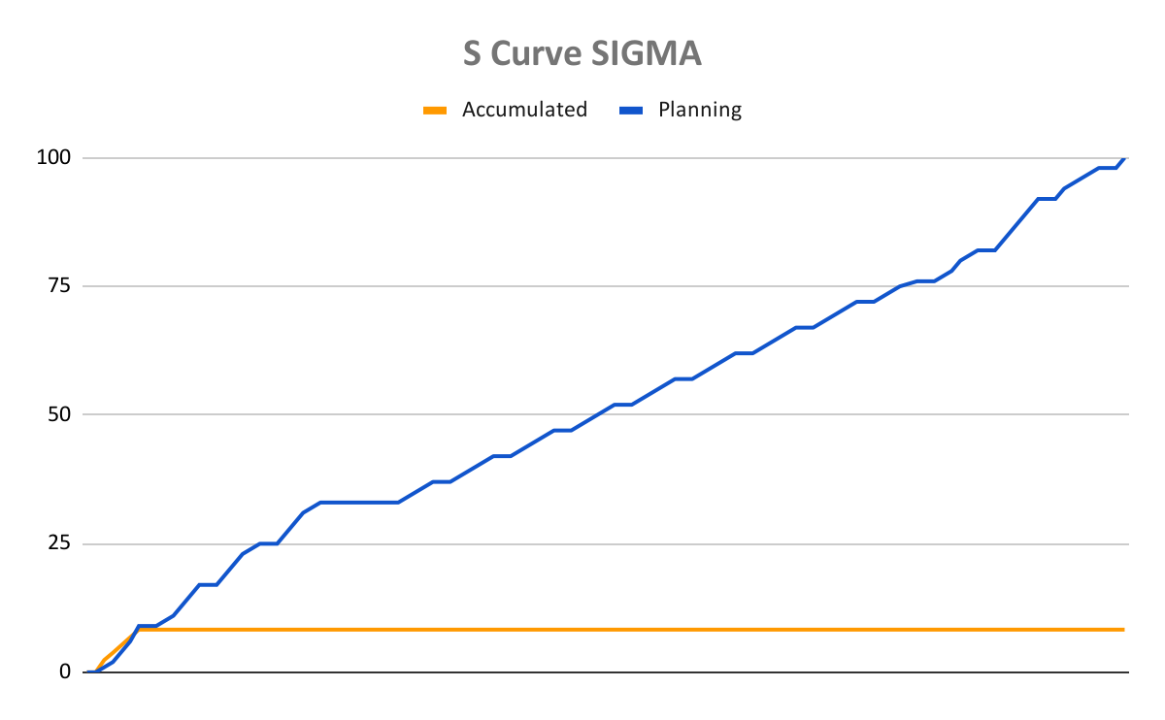
1.
Highlights Activity
Plan
9%
Actual
8.3%
Gap
0.7%
S-Curve Project
HIGHLIGHTS – Issue Project (Gap)
Penyesuaian Mock-up dengan bisnis proses dari SIGMA

Slide 4
2.
Activity of The Week
Activity | Date Start | Date End | Status
Kick Off Meeting | 03-03-2025 | 03-03-2025 | Done
Getting Requirement | 03-03-2025 | 07-03-2025 | In Progress
Penyusunan Business Blueprint | 03-03-2025 | 07-03-2025 | In Progress
Penyusunan Mock-up | 03-03-2025 | 03-03-2025 | In Progress

Slide 5
3.
Next Week Activity Plan
Activity | Date Start | Date End | Status
Getting Requirement | 07-03-2025 | 13-03-2025 | -
Penyusunan Business Blueprint | 07-03-2025 | 13-03-2025 | -
Penyusunan Mock-up | 07-03-2025 | 13-03-2025 | -
Persiapan Environment Development | 07-03-2025 | 13-03-2025 | -

Slide 6
